Slide 1


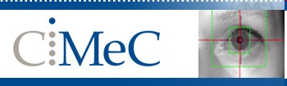
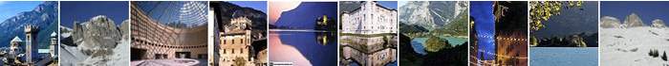
Magnetic Resonance Imaging:
Basic Introduction
Louvain-la-Neuve - Neuroimaging Workshop 2019
Jorge Jovicich
Center for Mind/Brain Sciences (CIMeC),
University of Trento, Rovereto, Italy
CIMeC: https://www.cimec.unitn.it/
MRI Methods Group: http://r.unitn.it/en/cimec/mri
E-mail: jorge.jovicich@unitn.it

Slide 2
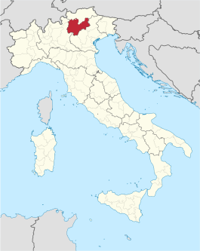
Introduction
Center for Mind/Brain Sciences, University of Trento, Italy
MRI Methods Group: http://r.unitn.it/en/cimec/mri
Focus on: Quantification of brain plasticity
General: Develop & apply novel MRI techniques to quantify brain plasticity
Specific: Optimize accuracy, reproducibility and sensitivity of brain plasticity metrics derived from anatomical, diffusion and functional MRI.
Developments
MRI Tools
Applications
Contrast optimization
Distortion correction
Reproducibility
Multicentric harmonization
Ex-vivo validations
Anatomical
Healthy
Blind
Deaf
Dementia
Psychosis
Schizophrenia
Surgery
Proton therapy
Diffusion
rsfMRI
1.5T, 3T, 7T, 9.4T
3T Prisma Siemens, CIMeC
Through collaborations

Slide 3
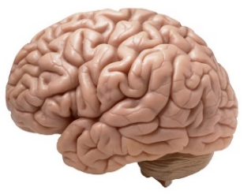
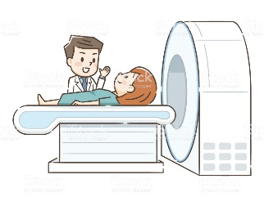
Concept map for lectures
Lecture 1
MR Image & Contrast
NMR Signal origin
MR Safety
Spatial encoding
Magnetic gradients
Pulse sequences
Powerful magnet
Radio frequency
Magnetic field gradients
Powerful magnet
Radio frequency
Magnetic field gradients
Lecture 2
Lecture 4
Structural MRI
Lecture 3
Functional MRI
Diffusion MRI
Contrast, important parameters
Sequences & artifacts
Analyses & applications
Contrast, important parameters
Sequences & artifacts
Pre-processing
Contrast, important parameters
Sequences & artifacts
Analyses & applications
Jorge Jovicich
CIMeC, University of Trento, Italy

Slide 4
Lecture 1 outline
NMR: Nuclear Magnetic Resonance
What is the source of the NMR signal?
How do we measure it?
How do we make images from it?
Jorge Jovicich
CIMeC, University of Trento, Italy

Slide 5
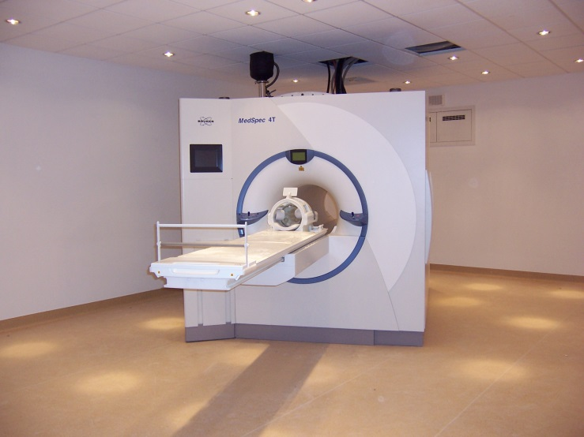
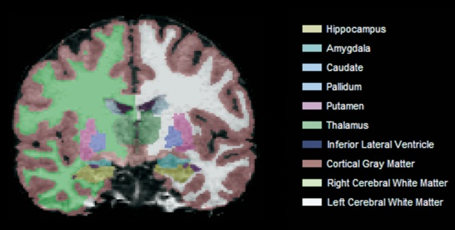
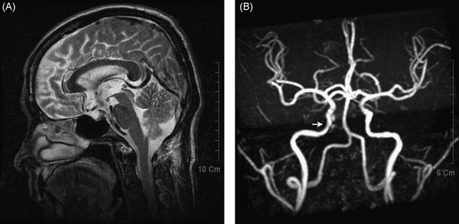
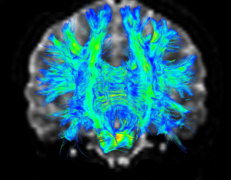
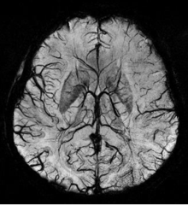
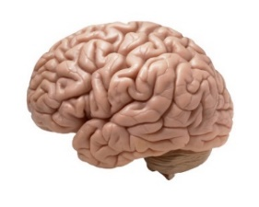
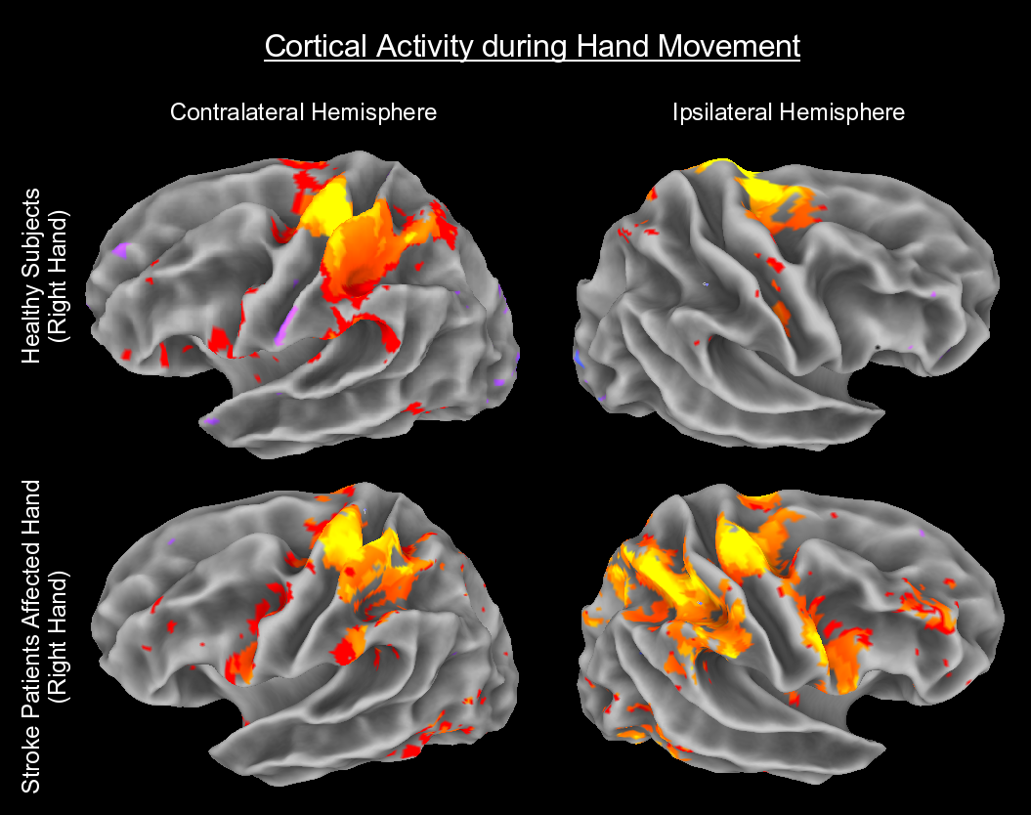
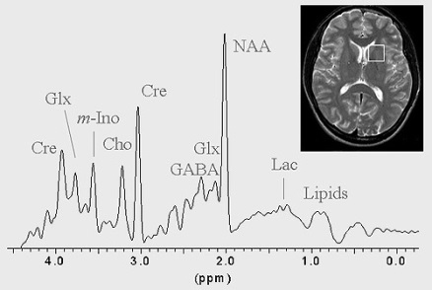
The «magic» of MRI
Quantification of multiple
tissue and physiology properties
One non-invasive
instrument
Where do foundations come from?
Analyses
Models
Etc.
Pulse
Sequences
Quantum mechanics
Jorge Jovicich
CIMeC, University of Trento, Italy

Slide 6
Pendulum analogy

Slide 7
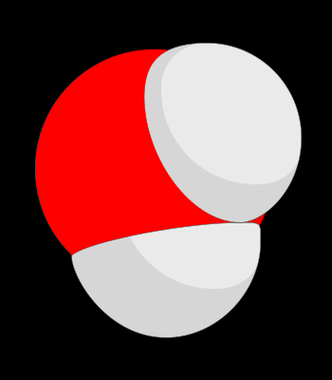
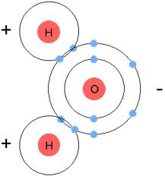
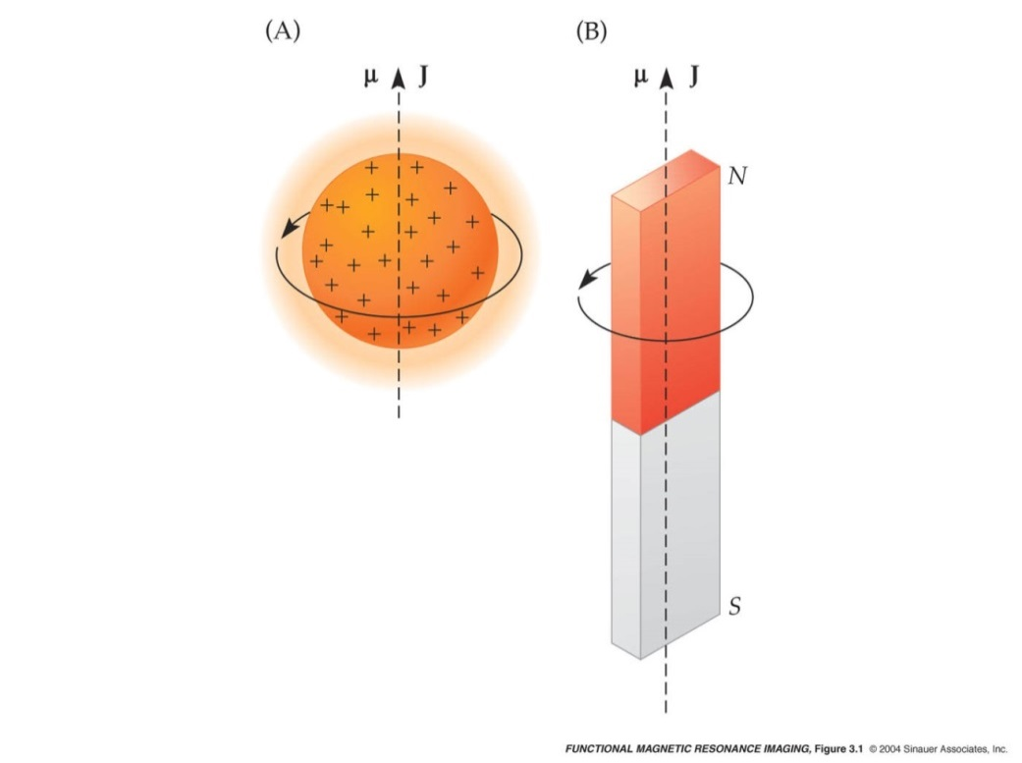

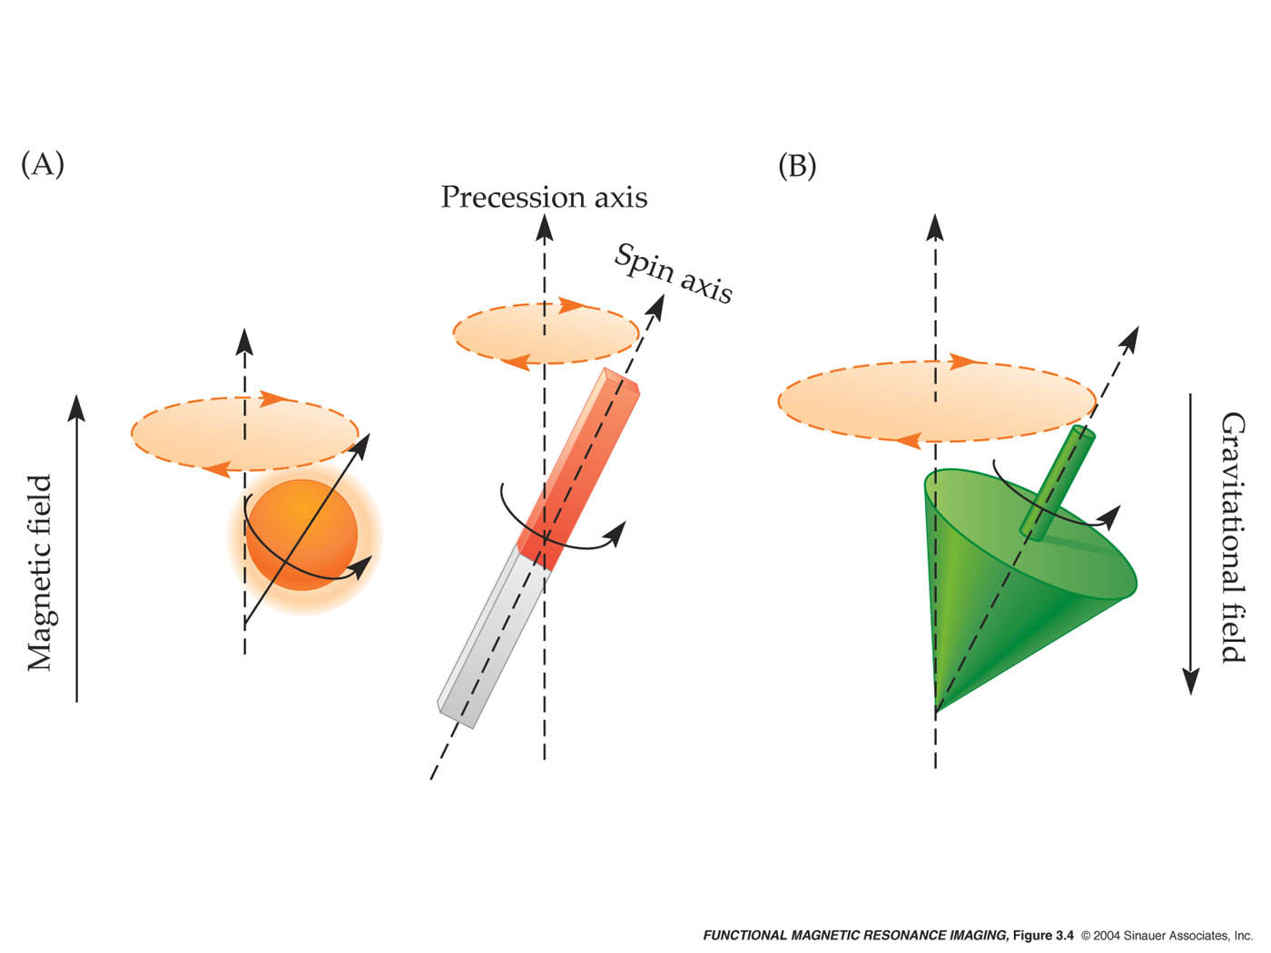
What is the source of an NMR signal?
When considering typical experiments with biologic tissue
Water molecules (H₂O)
The proton has a spin
(little magnet)
have hydrogen atoms,
each with a proton
Proton follows
external magnetic field
Angular rotation: ω = γ B
ω: Larmor frequency
γ: giromagnetic ratio (42.58 MHz/T)
B: local magnetic field
Jorge Jovicich
CIMeC, University of Trento, Italy

Slide 8
How do we obtain an NMR signal?
1) Create an equilibrium magnetization (M₀)
Put subject in a strong static magnetic field (e.g., 3T)
2) Excite the magnetization away from equilibrium
Transmit radio waves into subject [2~10 ms, mT]
3) Measure the signal induced as the magnetization relaxes to equilibrium
1
2
3
1
B₀
B₀
B₀
B₀
B₀
RF
NMR
signal
M₀
M₀
M_{(t)}
M_{(t)}
M_{(t)}
Equilibrium
time
Equilibrium
Jorge Jovicich,
Jorge Jovicich
CIMeC, University of Trento, Italy

Slide 9
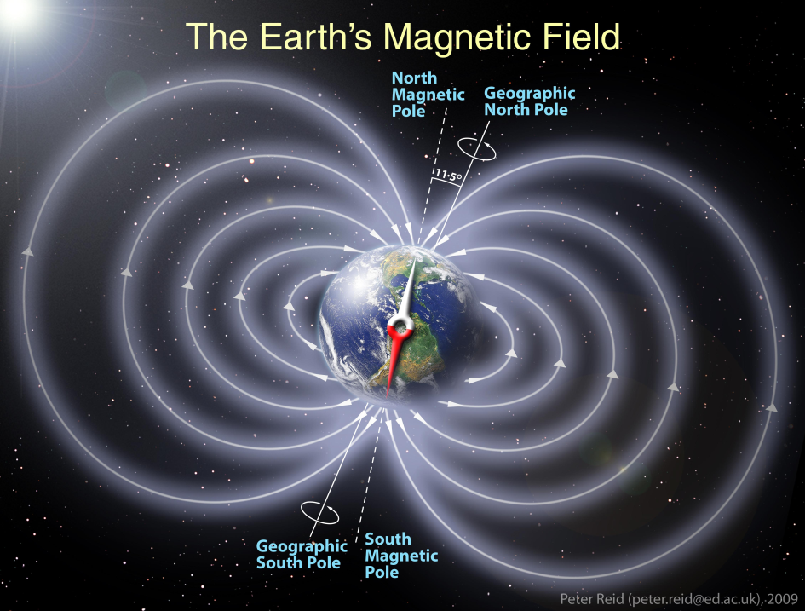
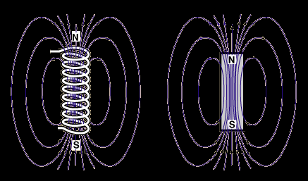
Need for a strong and uniform magnetic field
1 Tesla = 20,000x Earth’s magnetic field
Magnetic field
from a
coil & current
Magnetic field
from a
bar magnet
Jorge Jovicich
CIMeC, University of Trento, Italy

Slide 10
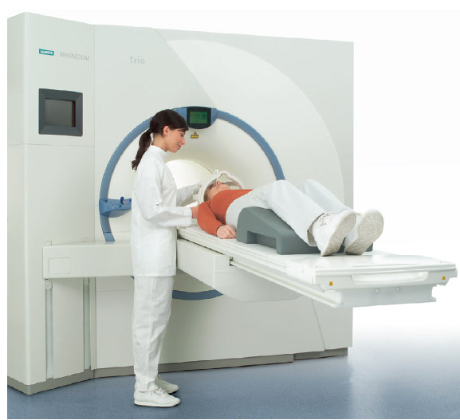
Where is the magnetic field in the MRI scanner?
B0 = constant magnetic field
(always on!)
Along z-axis
Superconducting coil
For fMRI
1.5T, 3T, 4T,
7T, and above…
Z
Jorge Jovicich
CIMeC, University of Trento, Italy

Slide 11
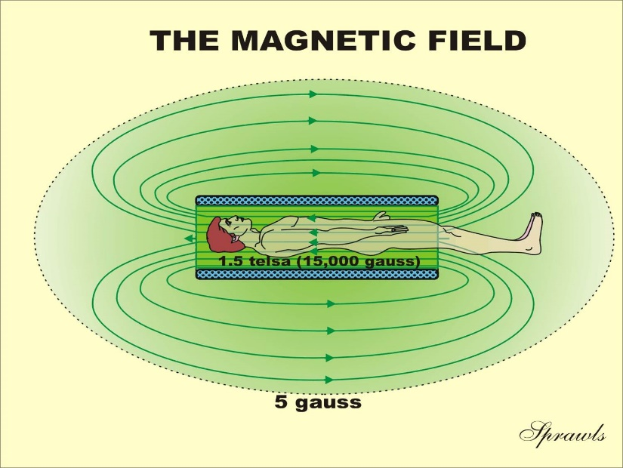
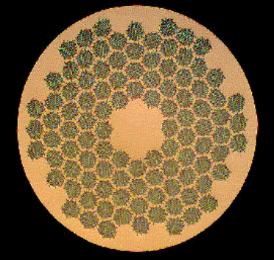
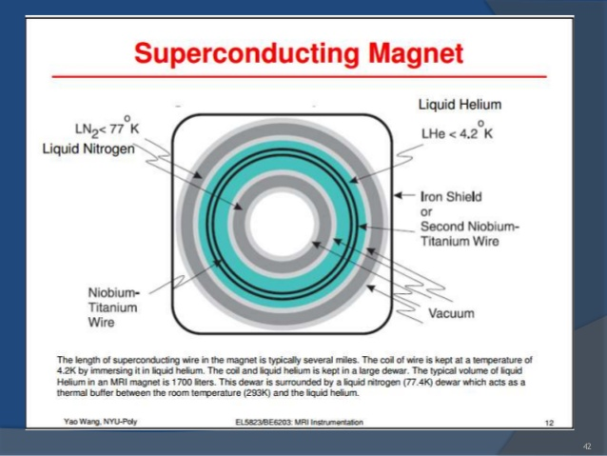
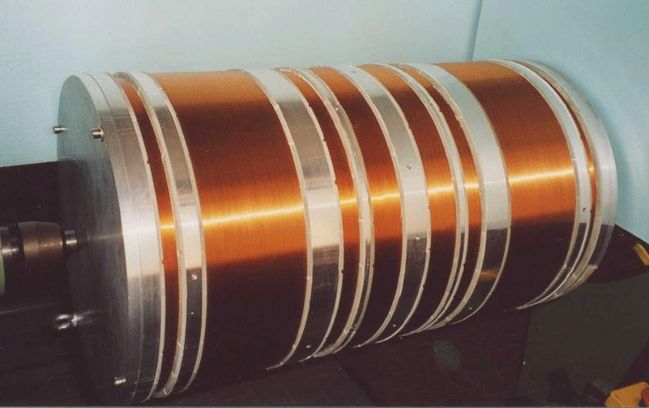
How do we generate a static magnetic field?
http://www.sprawls.org/mripmt/MRI02
Cross section of winding from a superconductive magnet with NbTi multifiliments embedded in a Cu core
http://mriquestions.com/superconductive-design.html
https://www.slideshare.net/padmanishailesh/mri-hardware
Jorge Jovicich
CIMeC, University of Trento, Italy

Slide 12
Quick review
NMR Signal
Equilibrium magnetization (Mo)
Excitation of Mo away from equilibrium
Relaxation of Mo to equilibrium
Jorge Jovicich
CIMeC, University of Trento, Italy

Slide 13
Sample in static magnetic field:
equilibrium magnetization
B_{o}
z
B_{o}
M_{o}
M_{o}
y
x
Net Equilibrium magnetization M₀:
- M_{z} aligned always with B₀
- M_{xy} = 0
- M₀ is the vectorial sum of millions of small magnetizations from the protons, which are all rotating at the same Larmor frequency, but out of phase
: uniform static magnetic field
: static macroscopic magnetization
: Larmor frequency
ω₀
Jorge Jovicich
CIMeC, University of Trento, Italy

Slide 14
Quick review
NMR Signal
Equilibrium magnetization (Mo)
Excitation of Mo away from equilibrium
Relaxation of Mo to equilibrium
Jorge Jovicich
CIMeC, University of Trento, Italy

Slide 15
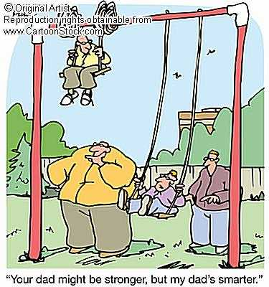
Magnetization excitation needs resonance
Magnetization excitation: radio frequency (RF) pulse at Larmor frequency
Need a resonant driving force
Like pushing a child on a swing
Child will absorb energy only if
transmitted at the right frequency
Jorge Jovicich
CIMeC, University of Trento, Italy

Slide 16
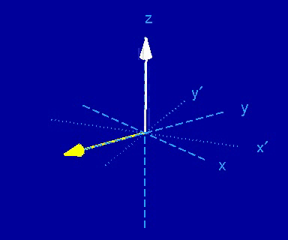
Excitation of the magnetization with an
external RF field
Source: Brian Hargreaves (mrsrl.stanford.edu/~brian/mri-movies/ )
Jorge Jovicich
CIMeC, University of Trento, Italy

Slide 17
What happens immediately after a RF pulse?
Equilibrium magnetization
in B₀ magnetic field
Magnetization after absorbing the RF
energy and rotating a fling angle α
z
RF excitation
flip angle α
z
M₀
RF
M_{z}
M
α
y
y
M_{xy}
x
x
M₀: magnetization at equilibrium
M: magnetization rotated by RF pulse
M_{z} = M₀ cos(α), longitudinal magnetization
M_{xy} = M₀ sin(α), transverse magnetization
Jorge Jovicich
CIMeC, University of Trento, Italy

Slide 18
Quick review
NMR Signal
Equilibrium magnetization (Mo)
Excitation of Mo away from equilibrium
Relaxation of Mo to equilibrium
Jorge Jovicich
CIMeC, University of Trento, Italy

Slide 19
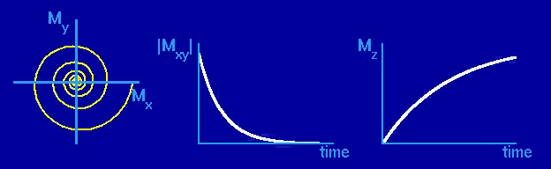
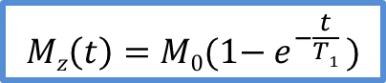
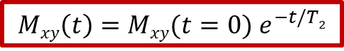
Transverse and longitudinal
magnetization relaxation to equilibrium
Magnetization M_{xy}
Transverse component
Magnetization M_{z}
Longitudinal component
Source: Brian Hargreaves (mrsrl.stanford.edu/~brian/mri-movies/ )
z
Decay of M_{xy} to equilibrium
Exponential
T₂: Charateristic decay time
Recovery of M_{z} to equilibrium
Exponential
T₁: Charateristic recovery time
M_{z}
M
α
$$Mxy\left(t\right)=Mxy(t=0){ e}^{−t/T2}$$
$$Mz\left(t\right)=M0(1−{ e}^{−\frac{t}{T1}} )$$
y
M_{xy}
x
Jorge Jovicich
CIMeC, University of Trento, Italy

Slide 20
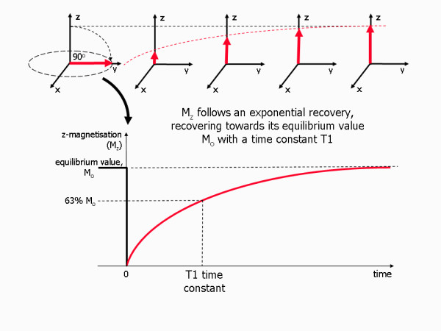
What is the T1 relaxation?
Jorge Jovicich
CIMeC, University of Trento, Italy

Slide 21
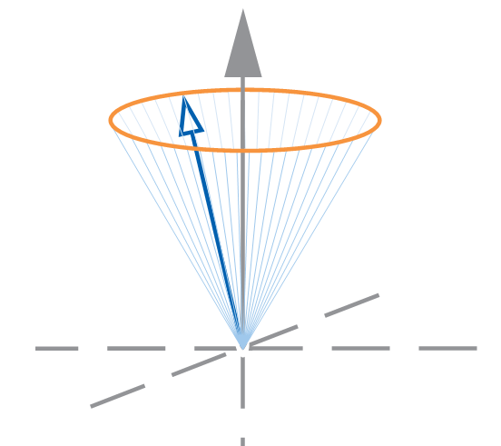
What is the T2 relaxation?
After the RF, each proton spin has a slightly different ω₀=γB₀
Some go slower, some faster ⇒ they come out of phase
Net transverse magnetization M_{xy} decays to zero (equilibrium)
90° pulse
T2 relaxation
Equilibrium
Immediately after RF pulse
After RF pulse
Jorge Jovicich
CIMeC, University of Trento, Italy

Slide 22
What is happening during T2 relaxation?
M_{xy(t)}
Loss of phase coherence
Jorge Jovicich
CIMeC, University of Trento, Italy

Slide 23
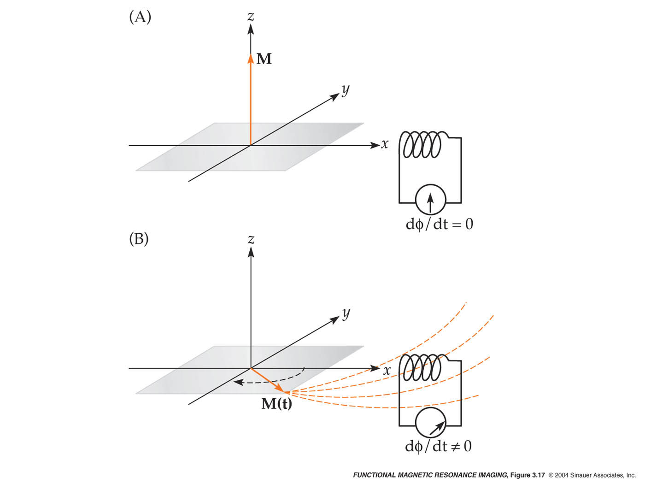
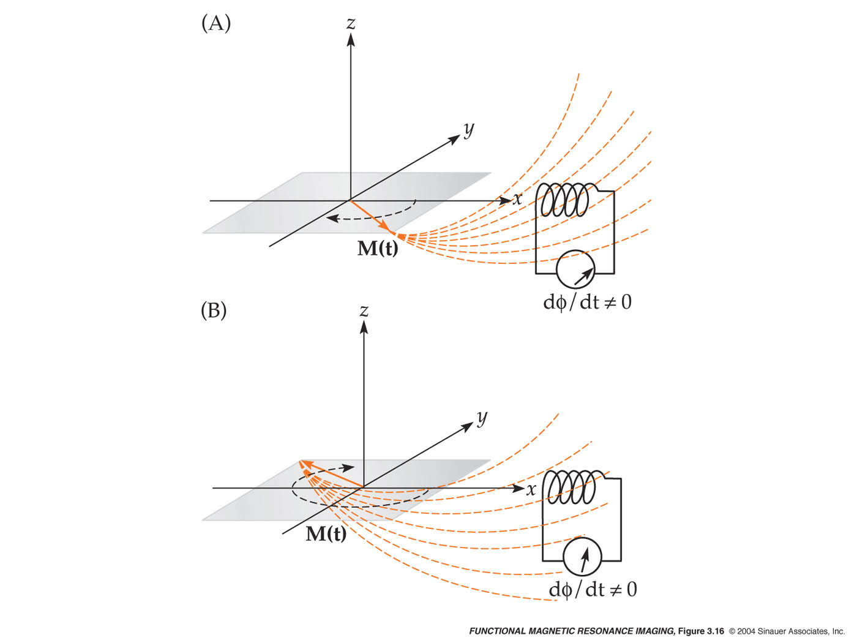
Where is the NMR signal coming from?
RF
time
Spectra
(Fourier Transform
of time signal)
M_{xy}
(Signal)
time
υ
υ_{o}
ω_{ο} = γ B_{ο}
Jorge Jovicich
CIMeC, University of Trento, Italy

Slide 24

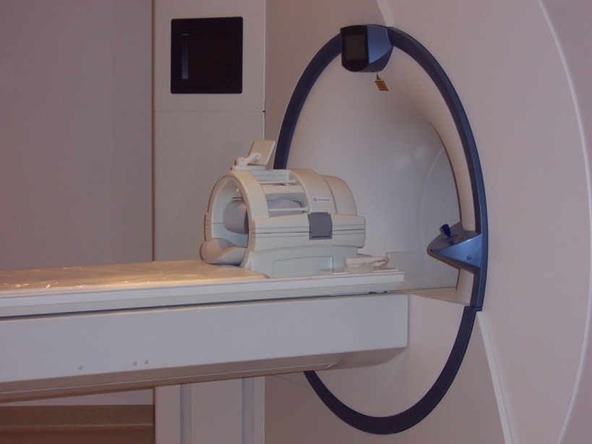
The radiofrequency (RF) coil
Transmits RF excitation pulse
Receives RF induction signal
Jorge Jovicich
CIMeC, University of Trento, Italy

Slide 25
Relaxation of magnetization to equilibrium
RF
time
time
z
RF excitation
flip angle α
Voltage
(Signal)
time
time
Mz
ω_{ο} = γ B_{ο}
M_{z}
M
α
Mz: exponential recovery
(relaxation time T1)
y
M_{xy}
time
time
Mxy
x
Mxy: exponential decay
(relaxation times T2, T2*)
M: magnetization rotated by RF pulse
M_{z} = M cos(α), longitudinal magnetization
M_{xy} = M sin(α), transverse magnetization
time
time
Jorge Jovicich
CIMeC, University of Trento, Italy

Slide 26
Why are relaxation times so important?
T1 and T2 reflect the local tissue environment
From Mike Moseley
Jorge Jovicich
CIMeC, University of Trento, Italy

Slide 27
What do relaxation times actually mean?
From Mike Moseley
T1 relaxation
Related to water rotational times
Free protons (cerebral spinal fluid) -> long T1 relaxation
Bound protons (myelin water) -> short T1 relaxation
Jorge Jovicich
CIMeC, University of Trento, Italy

Slide 28
What do relaxation times actually mean?
From Mike Moseley
T1 relaxation
Related to water rotational times
Free protons (cerebral spinal fluid) -> long T1 relaxation
Bound protons (myelin water) -> short T1 relaxation
T2 relaxation
Related to water translational (diffusion) times
Free protons (cerebral spinal fluid) -> long T2 relaxation
Bound protons (myelin water) -> short T2 relaxation
Jorge Jovicich
CIMeC, University of Trento, Italy

Slide 29
What do relaxation times actually mean?
From Mike Moseley
Brain tissue
Bound protons
Short T1 relaxation
Short T2 relaxation
Cerebral Spinal Fluid (CSF)
Free protons
Long T1 relaxation
Long T2 relaxation
Jorge Jovicich
CIMeC, University of Trento, Italy

Slide 30
An imperfect world: T₂* decay
Real signal decays faster than T₂ predictions
Pure T₂: random spin-spin interactions with perfect
homogeneous external B0
In reality: Field is inhomogeneous (B_{real} = B₀ + ΔB)
Signal decay due to random and fixed dephasing effects: T₂*
M_{xy}
ω_{ο} = γ B_{ο}
Voltage
(Signal)
time
Jorge Jovicich
CIMeC, University of Trento, Italy

Slide 31
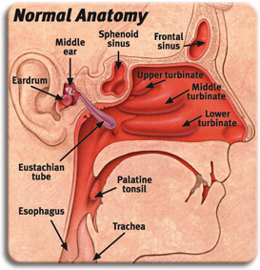
Where in the head is T2* short?
The brain that is close to the frontal
sinues will be challenging for fMRI
Jorge Jovicich
CIMeC, University of Trento, Italy

Slide 32
Magnetization dynamics
Geometrical description: damped precession
B₀
B₀
B₀
B₀
B₀
RF
NMR
signal
M₀
M₀
M_{(t)}
M_{(t)}
M_{(t)}
Equilibrium
time
Equilibrium
Mathematical Description: precession + relaxation (Bloch equations)
Jorge Jovicich
CIMeC, University of Trento, Italy

Slide 33
Quick review
NMR Signal
Equilibrium magnetization (Mo)
Excitation of Mo away from equilibrium
Relaxation of Mo to equilibrium
Jorge Jovicich
CIMeC, University of Trento, Italy

Slide 34
Summary of concepts introduced
What is the source of the NMR signal?
The equilibrium magnetization when sample is at B₀
The magnetization comes from protons, mostly in H₂O
Precession frequency at equilibrium: ω₀ = γ B₀
What do we need to measure an NMR signal?
Excitation pulse (B₁), must be on resonance (⊥ to B₀)
Magnetization rotated away from equilibrium (flip angle)
What are T1, T2 and T2* relaxation?
T1: Longitudinal magnetization recovery to equilibrium
T2: Transverse magnetization recovery to equilibrium (zero) considering only
proton-proton magnetic field interactions
T2*: like T2, but adding contributions from static magnetic field inhomogeneities
T1, T2 and T2* depend on local tissue environments
Jorge Jovicich
CIMeC, University of Trento, Italy

Slide 35
So far no image…
From the whole sample
No spatial selectivity
B₀
B₀
B₀
B₀
B₀
RF
NMR
signal
M₀
M₀
M_{(t)}
M_{(t)}
M_{(t)}
Equilibrium
time
Equilibrium
How can we put spatial information in the signal?
Jorge Jovicich
CIMeC, University of Trento, Italy

Slide 36
Spatial encoding concepts
After the RF excitation, in a uniform static magnetic field B₀, the NMR signal:
Comes from the whole sample: no spatial information
It decays exponentially with T2*
It oscillates at ω_{ο}
time
If I could vary net magnetic field in space (B=B₀ + something)
Then the measured frequency will change following the same law
Then frequency and space will be related
Then measuring frequencies tells us where the signal comes from
We are encoding spatial information in the signal
Jorge Jovicich
CIMeC, University of Trento, Italy

Slide 37
Spatial encoding with a magnetic field gradient
WHY?? To modulate the resonance frequency as function of space
WHY?? To measure frequencies and know where they come from
linear magnetic
field gradient
I know
these
Then:
If I can
measure
this
I can
calculate
this
Jorge Jovicich
CIMeC, University of Trento, Italy

Slide 38
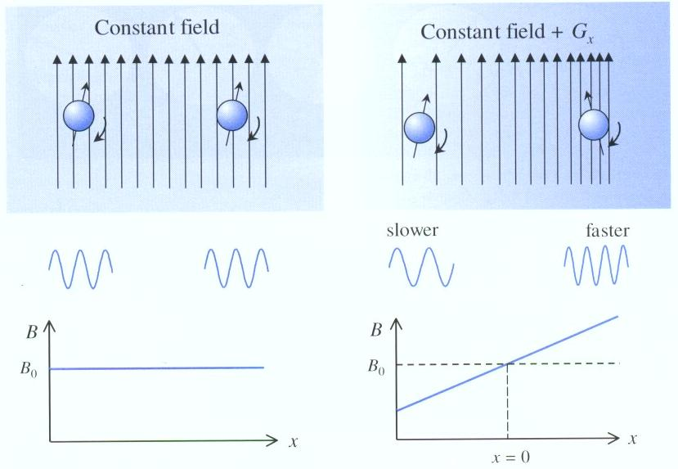
Effect of a magnet gradient
Jorge Jovicich
CIMeC, University of Trento, Italy

Slide 39
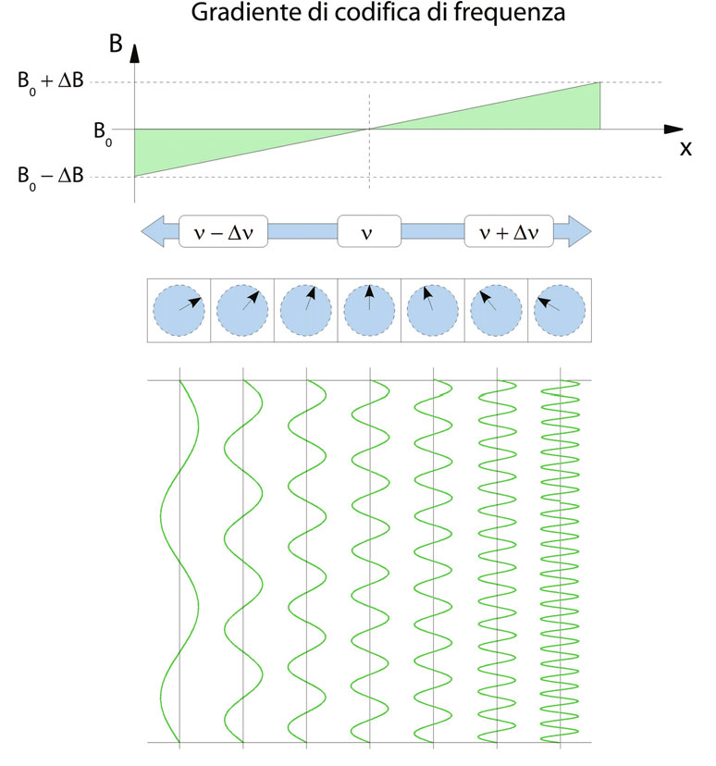
Magnetic gradients: phase and frequency
Gradient along x-axis
Two spatial-encoding possibilities for the magnetization:
Phase changes along x-axis
Frequency changes along x-axix
Jorge Jovicich
CIMeC, University of Trento, Italy

Slide 40
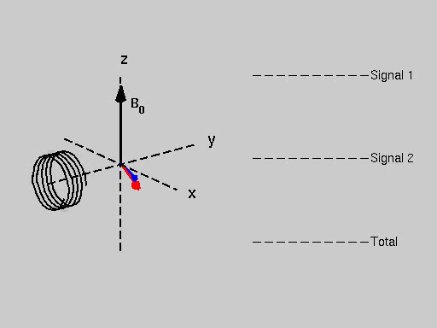
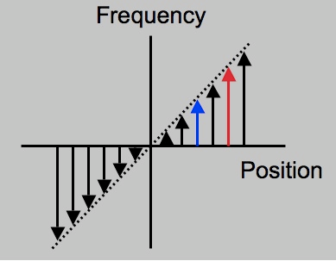
Effect of a magnet gradient
A linear gradient is turned on
Let’s look spins in the blue and red position
Source: http://mrsrl.stanford.edu/~brian/mri-movies
Jorge Jovicich
CIMeC, University of Trento, Italy

Slide 41
Spatial encoding concepts
Key points so far:
Magnetic field gradients encode spatial information in the frequency of the NMR signal:
So: the spatial information is in the signal frequency
But: the NMR signal measured is a signal that changes in time
So: To get spatial information we need to transform temporal information into frequency information
We need a Fourier Transform ‘massage’
to transform the measured signal (time)
into an image (signal of frequency)
Jorge Jovicich
CIMeC, University of Trento, Italy

Slide 42

Decomposing complex signals in simple waves
https://www.youtube.com/watch?v=cZgl7rJKs3A
Jorge Jovicich
CIMeC, University of Trento, Italy

Slide 43
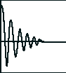
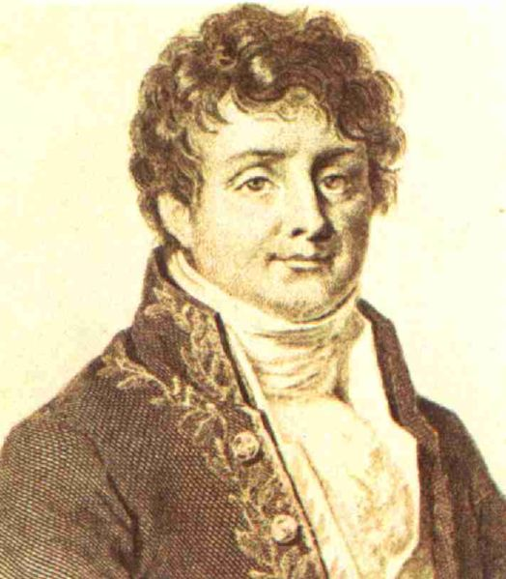
The Fourier transform
What is the Fourier Transform of a signal?
Signal Intensity as
function of time
Signal Intensity as
function of frequency
Fourier
Transform
time
ω₁
ω₂
ω
Equivalent
descriptions!
Joseph Fourier (1768-1830)
Signal as function of time
Signal as function of frequency
Jorge Jovicich
CIMeC, University of Trento, Italy

Slide 44
Fourier transform concepts
A
w₀
3w₀
w
Frequency space of signal S₃
Fourier Transform: strength of signal at each frequency
Jorge Jovicich
CIMeC, University of Trento, Italy

Slide 45
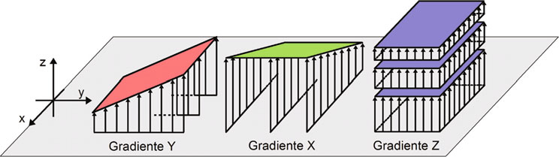
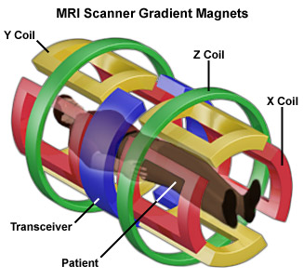
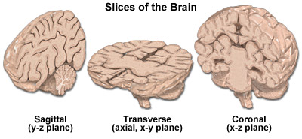
Magnetic field gradients in 3 dimensions
Need three orthogonal
magnetic gradients
Slice selection
Phase encoding
Frequency encoding
Images: http://www.magnet.fsu.edu/education/tutorials/magnetacademy/mri/page5.html
Jorge Jovicich
CIMeC, University of Trento, Italy

Slide 46
Overview of an MRI procedure
Tissue protons align
with magnetic field
(equilibrium state)
Magnetic field
Larmor Equation
Safety screening
RF pulses
Subject
Relaxation
processes
Protons absorb
RF energy
(excited state)
Spatial encoding
using magnetic
field gradients
Relaxation
processes
Protons emit RF energy
(return to equilibrium state)
NMR signal
detection
Repeat
RAW DATA
MATRIX
Fourier transform
S_{(x1,x2)}
IMAGE
S_{(t1,t2)}
Jorge Jovicich
CIMeC, University of Trento, Italy

Slide 47
What is an NMR or MRI pulse sequence?
A sequence of RF and gradient pulses which gives NMR signals
The signal we measure is in
spatial frequency space (k-space)
Jorge Jovicich
CIMeC, University of Trento, Italy

Slide 48
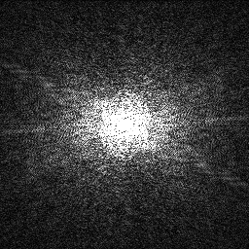
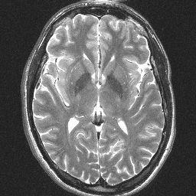
Why are we talking about this?
What we actually measure
What we want
Fourier
Transform
Data in: K-space
(“signal space”)
Same data in image space
(frequency of signals)
The spatial information is in the frequency of the measured signal
Jorge Jovicich
CIMeC, University of Trento, Italy

Slide 49
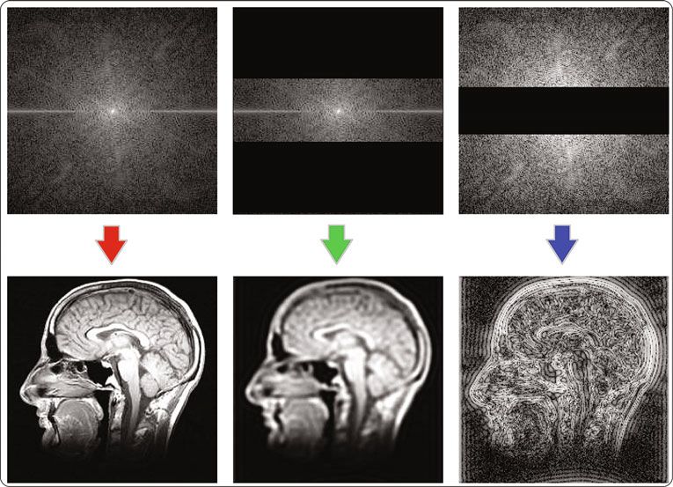
Understanding k-space
Jorge Jovicich
CIMeC, University of Trento, Italy

Slide 50
Understanding k-space
Jorge Jovicich
CIMeC, University of Trento, Italy

Slide 51
Understanding k-space
Jorge Jovicich
CIMeC, University of Trento, Italy

Slide 52
What is needed to obtain an MRI?
NMR experiment combining these three gradients:
Select a slice (RF excitation + Gslice)
Select a row (signal acquisition + Gread)
Select a column (Gphase before signal)
B₀
B₀
B₀
B₀
B₀
RF
NMR
signal
acquisition
For the
NMR
signal:
M₀
M₀
RF
excitation
M_{(t)}
M_{(t)}
M_{(t)}
time
Equilibrium
Equilibrium
For spatial
encoding of
the NMR signal:
G_{slice}
G_{phase}
G_{read}
Jorge Jovicich
CIMeC, University of Trento, Italy

Slide 53
Summary of concepts introduced
What is the source of the NMR signal?
What do we need to measure an NMR signal?
What are T1, T2 and T2* relaxation?
How is spatial information encoded in the NMR?
What is a pulse sequence?
Jorge Jovicich
CIMeC, University of Trento, Italy

Slide 54
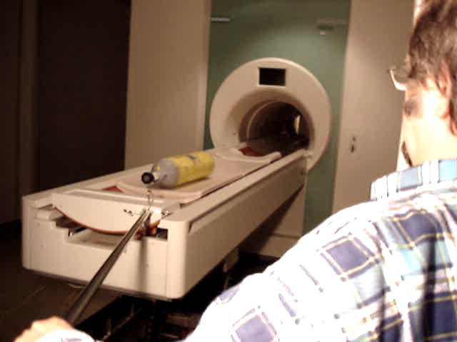
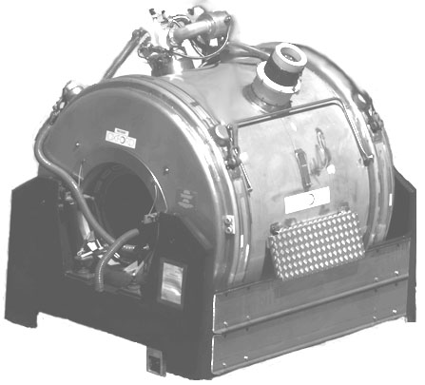
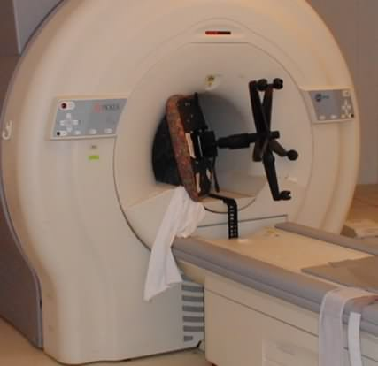
MRI Risks & Safety
Static magnet (always on)
(1.5T , 3T, 7T– 11.7 T)
Earth ∼10⁻⁵ T
Projectiles
https://www.dailymotion.com/video/x2y23p7
Jorge Jovicich
CIMeC, University of Trento, Italy

Slide 55






MRI Risks & Safety
Static magnet (always on)
(1.5T , 3T, 7T– 11.7 T)
Earth ∼10⁻⁵ T
RF Coil
(8-64 channels)
Magnetic gradient coil
(40-100 mT/m
∼100 A in ∼100 μs)
Projectiles
Heating
Peripheral nerve stimulation
Acoustic noise
Jorge Jovicich
CIMeC, University of Trento, Italy

Slide 56



Acoustic stimulation during MRI
Structural
MPRAGE
Structural
Diffusion
Functional
EPI
Jorge Jovicich
CIMeC, University of Trento, Italy

Slide 57



Risks and safety procedures are known
Unfortunately, accidents still happen
Jorge Jovicich
CIMeC, University of Trento, Italy

Slide 58
MRI Risks & Safety
MRI studies are safe if proper precautions are taken
Summary of precautions
Annual safety training review (MRI lab staff and users)
Always be aware of the potential dangers of MRI
Never take anything metal into the scan room
Always make safety a top priority while in the MRI environment
More information about MRI safety issues:
http://www.mrisafety.com/
http://www.radiology.upmc.edu/MRsafety/
Jorge Jovicich
CIMeC, University of Trento, Italy

Slide 59
MRI educational links include:
General MRI information sites include:
http://www.cis.rit.edu/htbooks/mri
http://mriquestions.com/
http://www.fmri4newbies.com/
https://www.imaios.com/en/e-Courses/e-MRI
Other:
http://matt.might.net/articles/ways-to-fail-a-phd/
https://gate.nmr.mgh.harvard.edu/wiki/whynhow/
Jorge Jovicich
CIMeC, University of Trento, Italy

Slide 60
Concept map for lectures
Lecture 1
MR Image & Contrast
NMR Signal origin
MR Safety
Spatial encoding
Magnetic gradients
Pulse sequences
Powerful magnet
Radio frequency
Magnetic field gradients
Powerful magnet
Radio frequency
Magnetic field gradients
Lecture 2
Lecture 4
Structural MRI
Lecture 3
Functional MRI
Diffusion MRI
Contrast, important parameters
Sequences & artifacts
Analyses & applications
Contrast, important parameters
Sequences & artifacts
Pre-processing
Contrast, important parameters
Sequences & artifacts
Analyses & applications
Jorge Jovicich
CIMeC, University of Trento, Italy

Slide 61





What is the source of an NMR signal?
Historical perspective
Atoms (“indivisible” in Greek, Democritus 460-370 BC )
Atomic theory & experiments: hydrogen (Cavendish, ∼1766)
Atomic nuclei, proton (Rutherford, ∼1911)
Quantum theory (Planck, Einstein, Bohr, etc. starts early 1900)
Atomic nuclei: spin (Pauli, 1924)
Atomic nuclei in a gas can absorb energy in a magnetic field (Rabi, 1937)
Nuclear Magnetic Resonance (NMR)
NMR possible also in solid & liquids (Purcell & Bloch, 1945)
Magnetic gradients proposed to create MRI (Lauterbur & Mansfield, 1972)
Isidor Isaac Rabi
Nobel Price 1944
Edward Purcell & Felix Bloch
Nobel Price 1952
P. Lauterbur & P. Mansfield
Nobel Price 2003
Jorge Jovicich
CIMeC, University of Trento, Italy

